Slide 1
X-Ray Interactions

Slide 2
Objectives
Upon completion of this lesson, the student will be able to:
1. Distinguish between absorption, scattering, and transmission of x-ray photons.
2. Identify the factors that affect the amount of attenuation.
3. Define half-value layer.
4. State five ways in which x-rays interact with matter.
5. Describe the two x-ray interactions important in image formation

Slide 3
Key Terms
● absorption
● attenuation
● beam quality
● beam quantity
● coherent scattering
● Compton scattering
● half-value layer
● pair production
● photodisintegration
● photoelectric effect
● photoelectron
● radiolucent
● radiopaque
● scattering

Slide 4
Introduction
X-ray photons entering a patient can be absorbed, scattered, or transmitted.
When an x-ray photon is absorbed in a patient, all of the energy is transferred to the patient’s tissue.
Scattering changes the x-ray photon direction and reduces its energy.
Scatter contributes to radiation fog and reduces image contrast.
Transmitted x-ray photons pass through the patient without interaction and form the radiographic image.

Slide 5
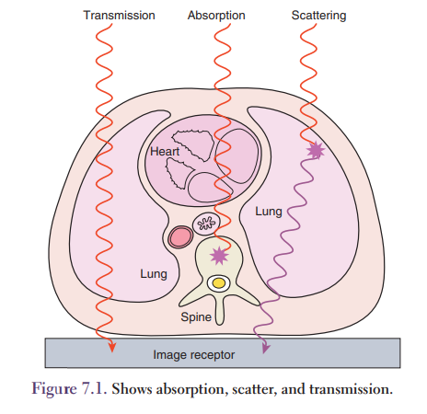
Introduction
Most diagnostic x-ray photons are absorbed or scattered.
Only about 1% of the x-ray photons are transmitted through the patient.
Radiation leaving the patient is termed exit radiation.
Exit radiation consists of transmitted and scattered x-ray photons.

Slide 6
Attenuation
Attenuation is the removal of x-ray photons from the beam by either absorption or scattering.
Attenuation occurs when the x-ray beam passes through matter and
there is a complete or partial loss of the x-ray photon energy in the patient.
Some x-ray photons will pass completely through the patient without interacting with the tissue (Fig. 7.1).

Slide 7
Attenuation
Other x-ray photons will interact with an orbital electron, the whole atom, or just the nucleus.
Upon interacting with tissue there will be either complete energy loss termed absorption and partial energy loss called scattering.

Slide 8
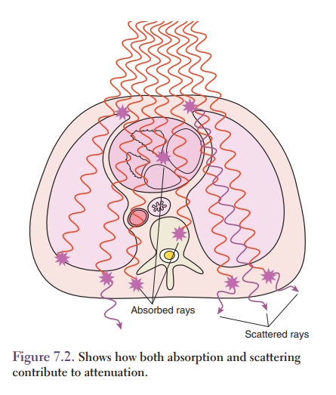
Attenuation
When the photon energy is absorbed and completely transferred to the tissue, the photon will no longer exist.
A photon that interacts and then scatters still has enough energy to go on to interact with another atom.
This process will continue until the photon is completely out of energy and absorbed into the tissue (Fig. 7.2).

Slide 9
Attenuation
The amount of attenuation depends on the:
1. x-ray photon energy
2. tissue thickness
3. tissue density
4. tissue material (atomic number)
These factors all influence the final radiographic image.

Slide 10
X-Ray Photon Energy
Higher x-ray photon energies (shorter wavelengths) have greater penetration and lower attenuation values.
Changing the x-ray photon energy, the keV, by changing the kVp will alter the penetration of the x-ray beam.
Lower energy x-ray photons have higher attenuation and lower penetration values.

Slide 11
Beam Quality and Quantity
Beam quality describes the penetration of the x-ray beam.
Higher kVp x-ray beams have higher penetration meaning they can pass completely through the patient with little or no absorption.
Beam quantity describes the amount of x-ray photons in the x-ray beam.
Beams with higher beam quantity produce images with less noise.
The amount of photons in the beam is controlled by the amount of mAs used to make the exposure.

Slide 12
Tissue Thickness
As the tissue thickness increases, more x-ray photons are attenuated, either by absorption or scattering.
More x-ray photons are attenuated by 22 cm of the tissue than by 16 cm of the tissue.
Technical exposure factors (mAs and kVp) must be adjusted to compensate for different tissue thicknesses.
Modern fixed x-ray units have automatic exposure control circuits designed to adjust the mAs to compensate for different patient thicknesses.
Exposure factors used with portable units must be selected by the radiographer.

Slide 13
Mass or Tissue Density
Mass density or subject density refers to how closely packed the atoms are in a tissue.
Density is measured in grams per cubic centimeter (g/cm³ ).
X-ray photon attenuation is increased in dense tissue.
Air or gas has the lowest density in the body.
Muscle is more dense than fat.
The attenuation of 1 cm of muscle is >1 cm of fat.
Bone is denser than muscle.
One centimeter of bone has more attenuation than 1 cm of muscle or fat.

Slide 14
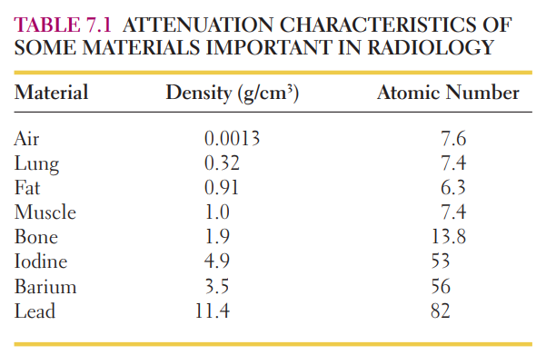
Table 7.1 lists the densities of some body tissues and materials important in radiology.

Slide 15
Tissue Material
Materials with higher atomic numbers (Z) have higher attenuation values.
Table 7.1 presents the atomic number of some tissues and materials common in diagnostic radiology.
Air, iodine, and barium are contrast materials often introduced into the body to improve image contrast.

Slide 16
Tissue Material
They are effective because their atomic numbers or their densities are significantly higher from the surrounding body tissues.
Substances that are highly attenuating are termed radiopaque and easily absorb x-ray photons.
Bone, barium, and iodine are examples of radiopaque substances.
Substances having low attenuation values are termed radiolucent.
Air, bowel gas, and lung tissue are relatively radiolucent and are easily penetrated by x-ray photons.
Lung is a combination of air spaces and tissue and has a density between air and muscle.

Slide 17
Half-value Layer
The half-value layer (HVL) is defined as the amount of material required to reduce the x-ray beam intensity to one-half its original value.
The HVL is affected by the amount of kVp and filtration in the beam.
Twice the thickness of material does not produce twice the attenuation because the average energy of the x-ray beam changes as it passes through the body.

Slide 18
Half-value Layer
The lower energy, less penetrating x-ray photons are removed from the beam so the exit beam is more penetrating and has a higher average energy than the entrance beam.
This removal of “soft” x-ray photons results in a hardening of the beam, which increases the ability of the x-ray photons to penetrate tissue.

Slide 19
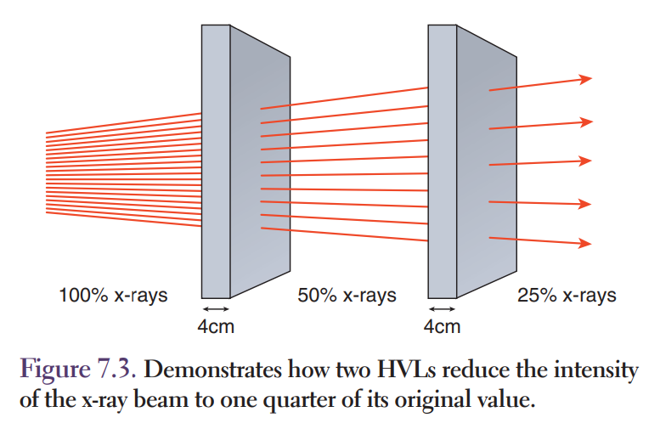
Half-value Layer
At diagnostic x-ray energies the HVL of soft tissue is about four centimeters.
Four centimeters of tissue reduces the x-ray intensity to one-half its original value.
The HVL describes the x-ray beam quality or penetration of the beam.
More penetrating x-ray beams have greater HVLs (Fig. 7.3).

Slide 20
Types of X-Ray Interactions
The five x-ray interactions possible in tissue are:
1. coherent scattering
2. photoelectric effect
3. Compton scattering
4. pair production
5. photodisintegration
These interactions take place between the x-ray photons and the target atoms in the tissue.
Only the photoelectric and Compton interactions are important in diagnostic radiology.

Slide 21
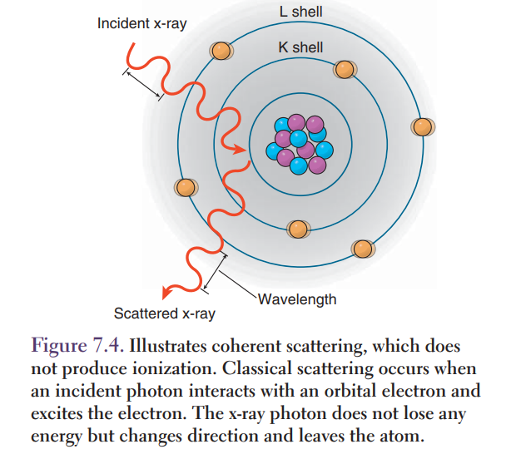
Coherent Scattering
Coherent scattering, also called classical scattering, occurs when the incident photon interacts with electrons in an atom causing the electrons to become excited and vibrate.
The excited atom immediately releases the excess energy as a scattered x-ray photon with the same wavelength as the incident photon.

Slide 22
Coherent Scattering
As seen in Figure 7.4, coherent scattering produces a change in x-ray photon direction with no change in energy.
It occurs primarily at energies below 10 keV and is not important in diagnostic radiology.
The other interactions transfer some energy from the incident photons to tissue and do produce ionization.

Slide 23
The Photoelectric Effect
In a photoelectric effect or interaction, the incident photon is completely absorbed by the atom.
The photon energy is totally transferred to an inner-shell electron.
The atom is ionized when this electron is ejected from the atom.
The ejected electron is called a photoelectron.

Slide 24

The Photoelectric Effect
The photoelectron has kinetic energy which is equal to the difference between the incident photon and the binding energy of the inner-shell electron.
This is shown mathematically in the equation:
where, Ei is the energy of the incident photon, Eb is the binding energy of the electron, and Eke is the kinetic energy of the photoelectron.

Slide 25
The Photoelectric Effect
For the interaction to occur, the incident photon needs an energy that is slightly greater than the binding energy of the electron.
Most of the atoms in tissue are very low atomic number elements and have very low K-shell binding energies.
The photoelectron is made up of matter and travels

Slide 26
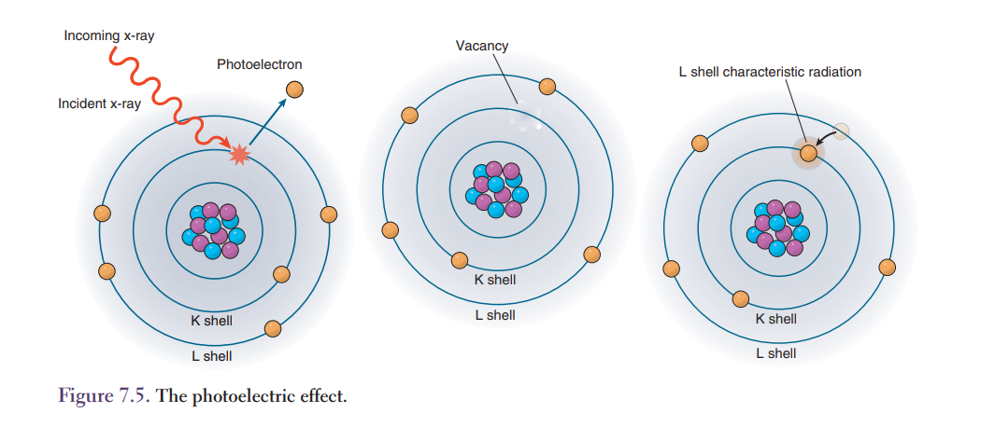

Slide 27
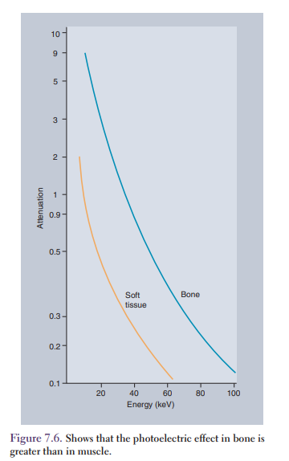
Variation of the Photoelectric Effect with Atomic Number
The photoelectric effect increases with increasing atomic number (Z).
Atoms with higher atomic numbers absorb more x-ray photons.
Bone absorbs more photons than muscle
because bone has a higher atomic number than muscle.
The attenuation of bone is four times greater than the attenuation of muscle at an x-ray energy of 40 keV (Fig. 7.6).

Slide 28
Variation of the Photoelectric Effect with Atomic Number
Barium and iodine are used as contrast agents because of their high atomic numbers.
This results in an increased photoelectric effect.
Structures containing these radiopaque contrast agents appear lighter or brighter on conventional radiographic images.

Slide 29
Variation of Photoelectric Effect with X-Ray Energy
The photoelectric effect decreases as the x-ray energy increases.
Figure 7.6 shows the photoelectric effect in bone and muscle as a function of energy.
At higher kVp settings there is less photoelectric effect in low atomic number structures such as soft tissues.

Slide 30
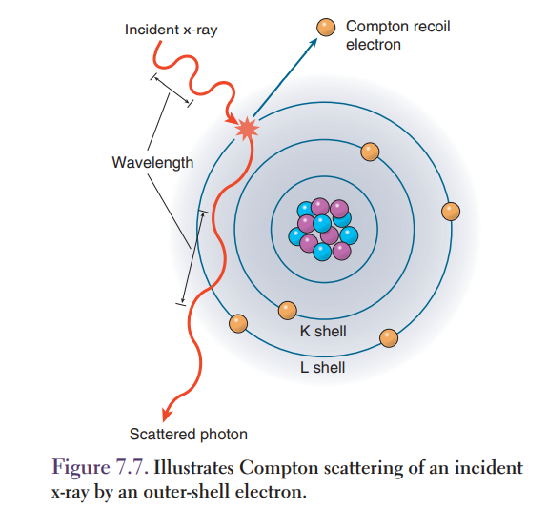
Compton Scattering
In Compton scattering, the incident x-ray photon interacts with a loosely bound outer-shell electron.
The incident x-ray photon ionizes the atom by removing an outer-shell electron, and then the photon continues in a different direction.

Slide 31
Compton Scattering
The energy of the incident photon is shared between the Compton or recoil scattered electron and the scattered x-ray photon.
The Compton scattered x-ray photon has lower energy and longer wavelength than the incident photon (Fig. 7.7)

Slide 32

Compton Scattering
The Compton effect is represented by the following formula:
where, Ei is the energy of the incident photon, Es is the energy of the Compton scattered photon, Eb is the electron binding energy, and Eke is the kinetic energy given to the Compton electron.

Slide 33
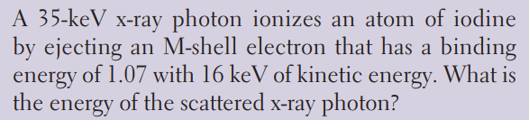
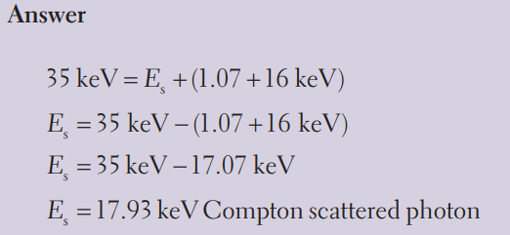

Slide 34
Compton Scattering
Compton scattering is almost independent of changes in material and atomic number.
During radiographic examinations of larger areas of the body more tissues are irradiated due to the larger field sizes, this produces more Compton scattering.

Slide 35
Compton Scattering
The scatter radiation emitted from the patient is the primary cause of occupational exposure for the radiographer.
Fluoroscopic examinations pose a serious radiation hazard due to the large amount of radiation that is scattered from the patient.
This is why it is crucial for the radiographer to wear a lead apron, thyroid shield, and gloves during all fluoroscopic examinations.

Slide 36
Compton Scattering
The amount of Compton scattering increases with increasing x-ray energy.
Compton scattered photons can be scattered in any direction up to 180 degrees.
The angle of deflection is influenced by the energy of the initial photon.
At a deflection of 0 degrees no energy is transferred because the photon does not change its path from the original direction.

Slide 37
Compton Scattering
As the deflection increases to 180 degrees, more energy is given to the recoil electron and less energy stays with the scattered photon.
When a scattered photon is scattered back in the direction of the incident photon, it is called backscatter radiation.
Backscatter radiation can cause artifacts on the radiographic image and decrease image quality.
The backscatter radiation deposits unwanted exposure on the image and is called radiation fog.
The increase in radiation fog causes a decrease in radiographic contrast.

Slide 38
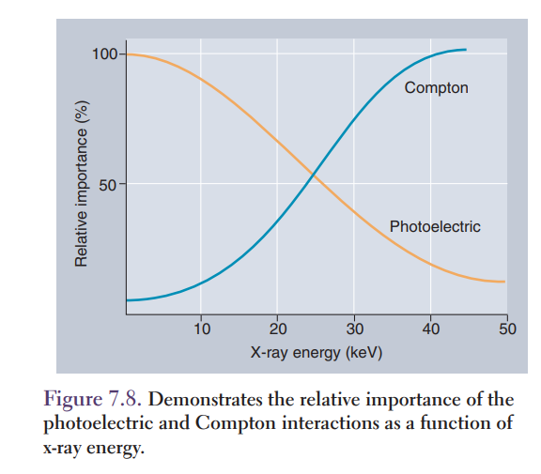
Only photoelectric and Compton interactions are important in diagnostic radiology.
At low energies, the Compton scattering and the photoelectric effect have nearly the same ratio of interactions, while at higher energies Compton scattering dominates (Fig. 7.8).

Slide 39
As demonstrated in Figure 7.8, when the incident x-ray photon energy is increased, the relative amount of the photoelectric interaction decreases and the relative amount of Compton scattering increases.

Slide 40
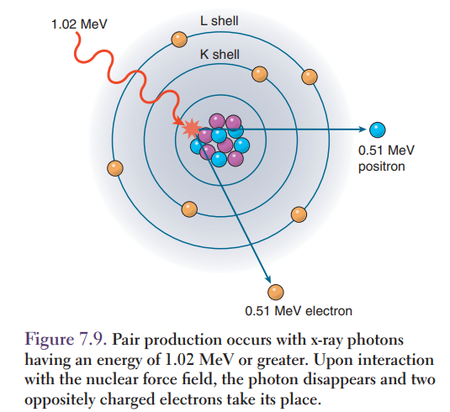
Pair Production
The incident x-ray photon must have energy of least 1.02 MeV for pair production to occur.
In pair production the incident x-ray photon is transformed into a positive and a negative electron pair when the high energy photon passes near the electrostatic force field of an atomic nucleus, causing the photon to disappear.

Slide 41
Pair Production
In its place one positive and one negative electron share the incident photon energy (Fig. 7.9).
Pair production does not occur at diagnostic radiology energies.

Slide 42
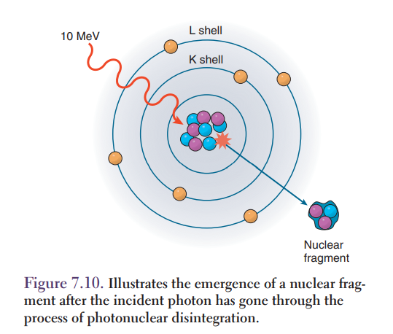
Photodisintegration
In photodisintegration, the incident x-ray photon has enough energy (>10 MeV) to break up the atomic nucleus.
When the incident photon strikes the nucleus it gives up all its energy to the nucleus; this interaction excites the nucleus.

Slide 43
Photodisintegration
The excited nucleus then emits a nuclear fragment (Fig. 7.10).
Both pair production and photodisintegration require extremely high-energy x-rays and are not utilized in diagnostic radiology.

Slide 44
Chapter Summary
X-rays entering a patient can be transmitted, absorbed, or scattered.
Attenuation is the combination of absorption and scattering.
Attenuation depends on energy, tissue material (atomic number), tissue thickness, and tissue density.
The HVL is the amount of material required to reduce the intensity to one-half its original value.
The HVL of tissue is about four centimeters.

Slide 45
Chapter Summary
Of the five possible types of interactions in tissues only the photoelectric and Compton interactions are important in diagnostic radiology.
The photoelectric effect results in complete absorption of the incident x-ray photon.
Photoelectric effects decrease with increasing x-ray energy and increase with increasing atomic number (Z).

Slide 46
Chapter Summary
Compton scattering changes the direction and energy of the x-ray photon.
Compton scattering contributes to the loss of contrast on the image and to occupational dose.
Photoelectric interactions are most important at lower x-ray photon energies, and Compton scattering is more important at higher x-ray energies.

